Slide 1

28/01/2022

Slide 2
Background
Impairment in social cognition and interaction in several psychiatry
SCZ AND MMD: reduced motivation to engage social interaction;
SCZ: over- interpret the meaning of social signals;
BPD: rapidly changing beliefs about others; polarize between approach and rejection.
Volatility learning
Impairment in the estimation of environmental volatility in SCZ, MDD and psychosis, and autism (over-estimation of volatility).
BPD failed to show increased learning rate in volatile environment.

Slide 3
Question:
Whether volatility and probability learning is equally affected when inferring on the hidden states of non-social and social outcomes across …
Whether the aberrant social learning and decision making were associated with differences in social anhedonia.
Method:
HGF as an Internal generative model of the sensory input
ANOVA
Notes:
Generative: how the input is generated by the external world
Internal: the agent belief of the how the input is caused.

Slide 4
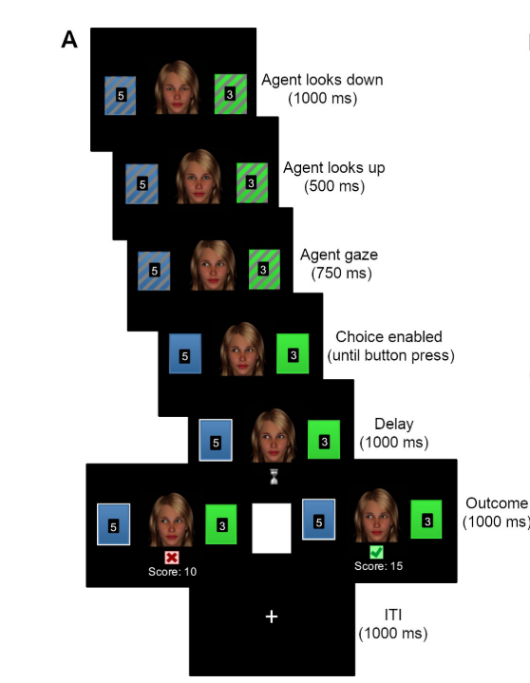
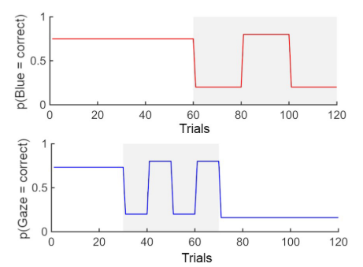
Paradigm

Slide 5
Observing the observer Framework
Meta- Bayesian : Bayesian infernece (by an experimenter) on Bayensian inference (by a subject) (Daunizeau et al., 2010a,b).
Perceptual model: How the posterior estimates provided by the agents’s model of how its sensory input is generated.
Decision/ response model: the agent observed actions (decision or responses) which are (probabilistic) consequences of the agent’s beliefs about its environment.

Slide 6
HGF
A hierarchical Bayesian model in which states evolve as coupled Gaussian random walks, such that each state determines the step size of the evolution of the next lower state (Mathys et al., 2011).
Based on a mean field approximation to the full Bayesian solution, we derived analytic update equations whose form resembles RL updates, with dynamic learning rates and precision-weighted prediction errors.

Slide 7


Gaussian random walk
Random walk (随机漫步）
Gaussian random walk
A random walk having a step size that varies according to a normal distribution, but not discrete random number, it is used as a model for real-world time series data such as financial markets.

Slide 8
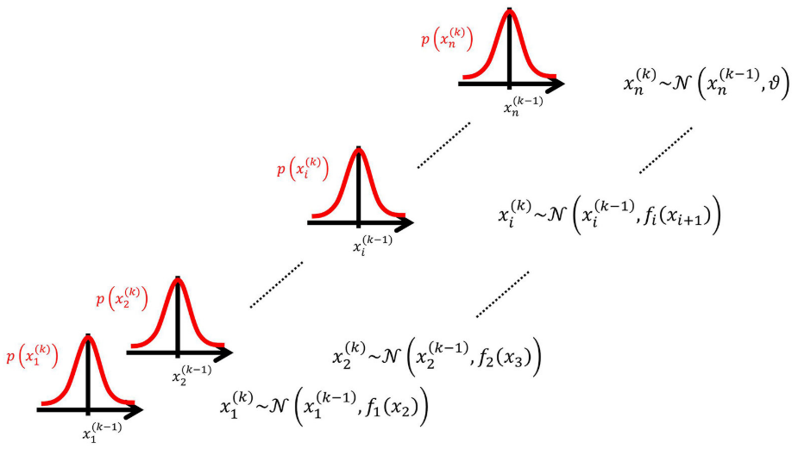


HGF
The volatility in x is governed by the function of a higher- level variable. (Volatility is defined as the variance of a time series per unit of time).
Notes:
Comprises a hierarchy of states that evolve in time as Gaussian random walks, with each walk’s step size determined by the next highest level of the hierarchy.
This model can be inverted (fitted) by an agent using a mean-field approximation and a novel approximation to the conditional probabilities over unknown quantities that replaces the conventional Laplace approximation. This enables us to derive closed-form update equations for the posterior expectations of all hidden states governing contingencies in the environment. This results in extremely efficient computations that allow for real-time learning.

Slide 9
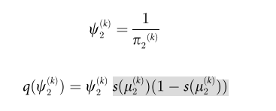

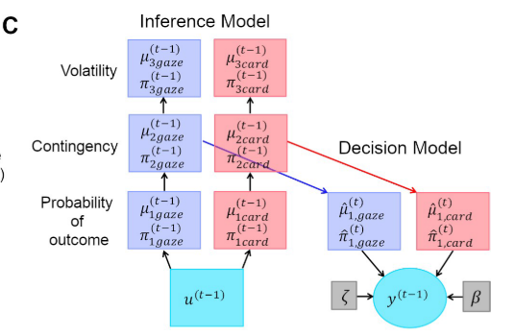




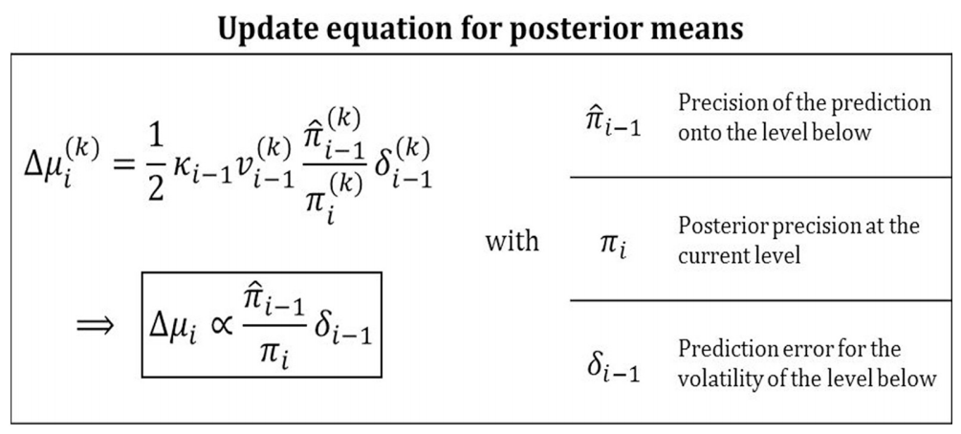
HGF in this study
u: sensory input (observations), u(k);
x(k): the hidden state
: the belief of the state.
: the precision of the posterior belief
Notes:
hat notation to indicate “referring to prediction.”
How to realize individual difference: parameters that determine the nature of the coupling between the levels of the hierarchical model, the optimality of an update is made conditional upon parameter values that may vary from agent to agent.
Ultimately, our approach may therefore be useful for model-based inference on subject-specific computational and physiological mechanisms of learning, with potential clinical applications for diagnostic classifications of psy- chiatric spectrum disorders (Stephan et al., 2009).

Slide 10


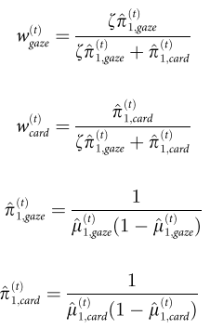

Response model
Belief to decision mapping
Logistic sigmoid function to model prob(gaze)
possible subject-specific non-linear distortions in weighting the expected reward
: inverse decision temperature.
Larger>> low decision noise >> high alignment between belief and choice
: the propensity to weight the social over the
non-social info.
Notes:
Computing this probability is called model inversion: unlike the likelihood p(u(k) |x(k) , x, u(1…k − 1) ) the posterior does not predict data (u(k)) from hidden states and parameters but predicts states and parameters from data.
Variational Bayesian inversion 确定参数和belief 的后验分布，同最大化evidence； 通过mean-field approximation 把posterior distribution 转变为边际后验概率的近似。

Slide 11
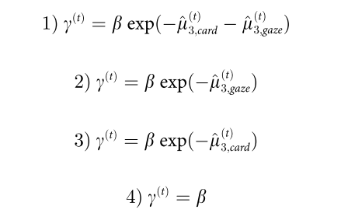
Response model
Participant specific decision noise

Slide 12
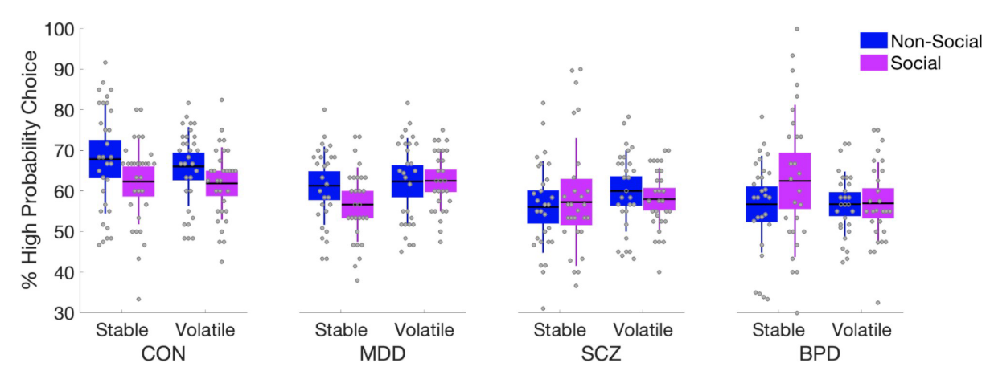
Behavioral Result (ANOVA 2(volatile) *2 (social/non-)*4)
Proportions of trials where the better option was chosen
SCZ and BPD was significantly worse than HC, MDD.
Cue types * Group interaction, HC and MMD show higher accuracy to non-social info, but BPD show the opposite pattern.

Slide 13
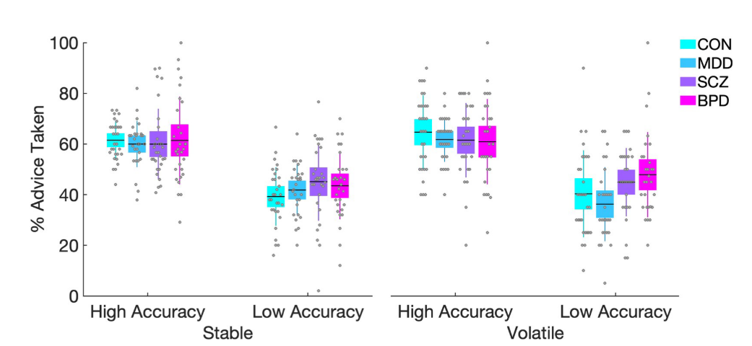
Behavioral Result
(ANOVA 2(volatile)*2(low/high Acc) *4)
Advice taking in social schedule
Follow advice more in high than low acc, but not by stable/volatile phases.

Slide 14
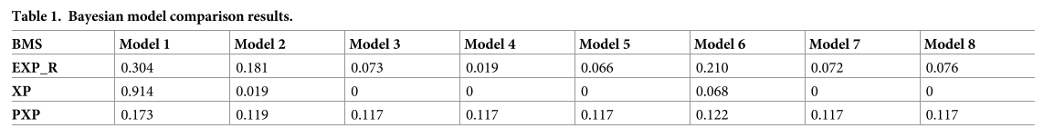
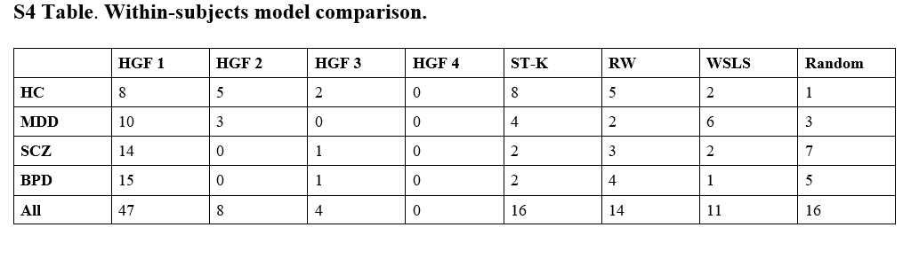
Bayesian model comparison & validity
Notes:
Bayesian Model Selection
EXP_R: the posterior probability of the prevalence of each model in the population;
XP: exceedance probability, the probability that a given model outperform all others in the comparison;
PXP: protected-XP, the possibility that all models are equally good.

Slide 15
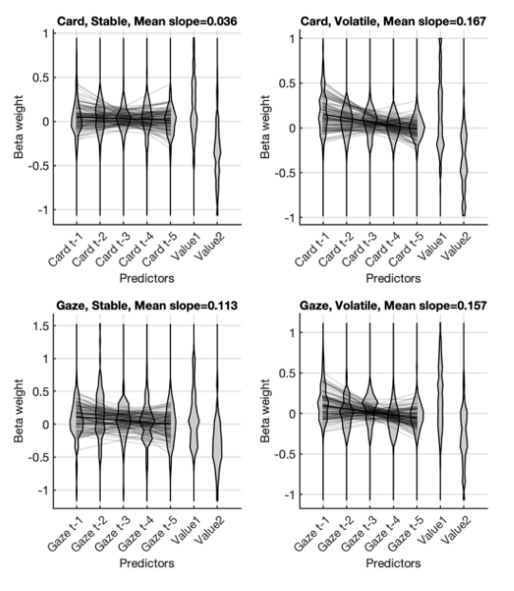
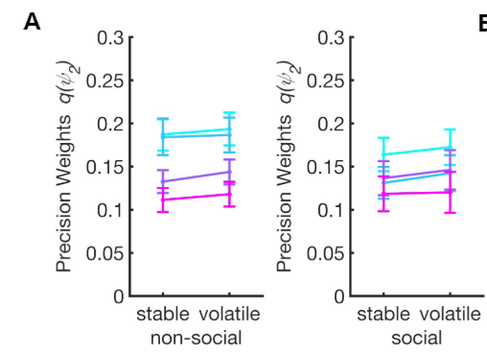
Result –learning rate – 2nd level
ANOVA (2*2*4)
Notes:
No-sig interaction between Phase and Information Type
BPD show lower decision weights on second level.

Slide 16
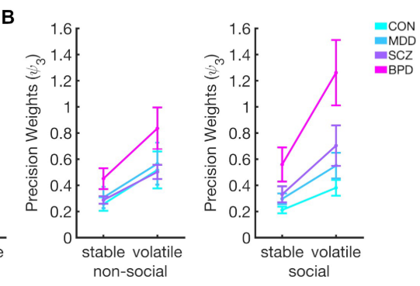
Result –learning rate – 3rd level
Main effect of phase
BPD higher precision weights for both modalities.
BPD stronger increase in precision weight in response to social compared to non-social.

Slide 17
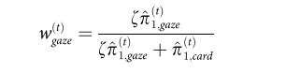
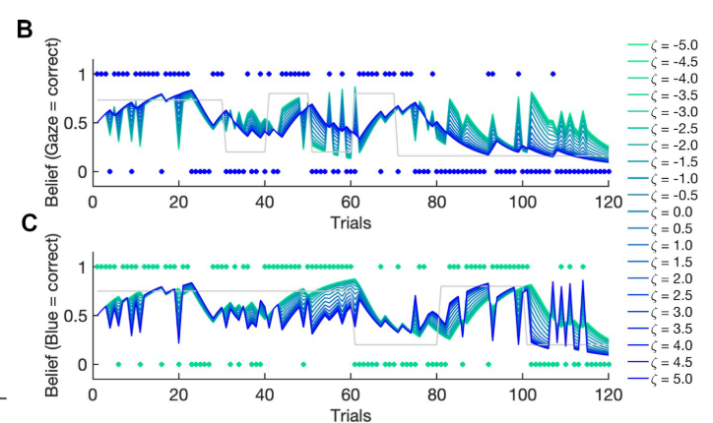
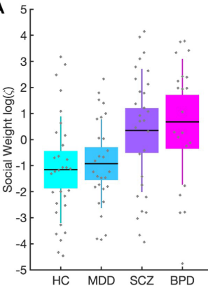
Result – social weighting
The effect of varying the social weighting factor
By simulating the combined belief b of agents with same perceptual parameters.

Slide 18
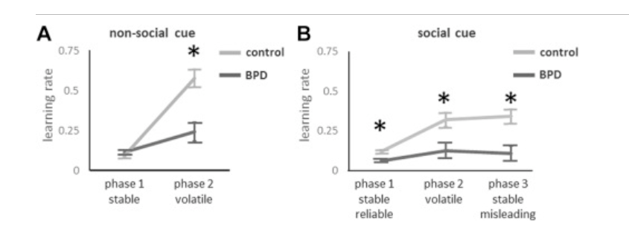
Discussion
1. the aberrant mechanism of BPD in social learning (Fig A.B)
2. ? other-subject specific parameters to characterize the volatility learning and contingency learning.

Slide 19
Conclusion
Limitations:
Lack of control conditions to examine the ability of probability learning in BPD, and SCZ.
As to HGF, generality (i) discrete and continuous environmental states, and(ii) deterministic and probabilistic relations between environmental and perceptual states (i.e., situations with and without perceptual uncertainty).

